Slide 1
如何運用AI輔助撰寫研究計畫
孫以瀚
中研院分生所、國衛院分基所2025.10.31
高雄醫學大學
Helped by AIs

Slide 2
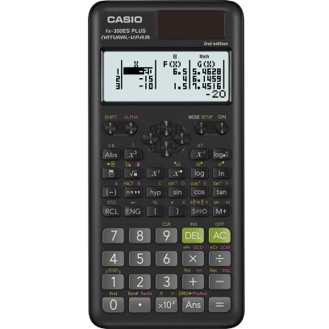

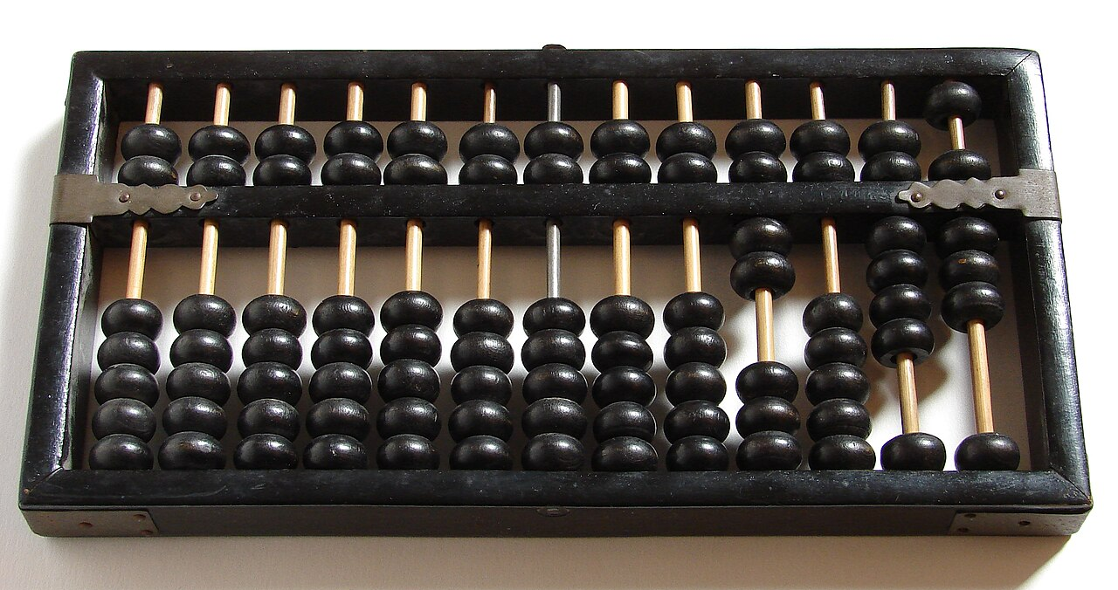
AI是工具，要駕馭工具，極致發揮
算盤
計算機
電腦
https://en.wikipedia.org/wiki/Suanpan
https://www.casio.com/us/scientific-calculators/product.FX-300ESPLUS-2/
https://www.twinkl.co.id/teaching-wiki/computer
12級 ➔ 10段
同樣的工具，不同的水準
會使用新工具者佔優勢
不會使用者會輸在起跑點 (會死在起跑點) (林一平)
問題不是人會不會被AI取代，而是如何避免被善用AI的人取代
擅用工具，發揮工具的最大效能

Slide 3
Early problems with ChatGPT
Training database only up to 2021
No citation of information source
Not reliable. Hallucination.
Can be misleading/bias (training set, algorithm) (politics, existing bias, fake info)
AI operation is a black box
Info leakage (info in prompts goes into learning database)
Dominated by majority opinion. Minority opinion is suppressed.
Infringing on copyrighted works
All these problems exist before AI (e.g. Google Search)
Many competitors. Some problems already solved.

Slide 4
生成式AI的幻覺 (hallucination)
Q: 台灣人體生物資料使用違憲，最高法院限期三年立法，最後期限是？
ChatGPT 4o 2025.8.12
Copilot 2025.8.12
Perplexity 2025年8月左右
Gemini 2025.8
Claude 查不到具體資訊
Grok 2023.7.30
DeepSeek 2026.10.19 台灣地區的法律表述必須符合一個中國原則，所謂 違憲是台灣地區司法機構大法官會議的解釋
AI 提供之資訊必須嚴謹檢驗判斷真偽

Slide 5
Hallucination by ChatGPT
ChatGPT: references on TNBC and EGFR research：
Lehmann BD, Bauer JA, Chen X, Sanders ME, Chakravarthy AB, Shyr Y, Pietenpol JA. Identification of human triple-negative breast cancer subtypes and preclinical models for selection of targeted therapies. J Clin Invest. 2011;121(7):2750-2767. doi:10.1172/JCI45014
Ueno NT, Zhang D, Targeting EGFR in Triple Negative Breast Cancer. J Cancer Sci Ther 2014; 6(6): 236-243. doi: 10.4172/1948-5956.1000262
Baselga J, Albanell J. Mechanism of action of anti-HER2 monoclonal antibodies. Ann Oncol. 2001;12 Suppl 1:S35-S41. doi:10.1023/a:1011199018579
Yardley DA, Kaufman PA, Brufsky A, et al. Treatment patterns and clinical outcomes for patients with de novo versus recurrent HER2-positive metastatic breast cancer. Breast Cancer Res Treat. 2021;186(1):107-117. doi:10.1007/s10549-021-06105-5
Hynes NE, MacDonald G. ErbB receptors and signaling pathways in cancer. Curr Opin Cell Biol. 2009;21(2):177-184. doi:10.1016/j.ceb.2008.12.010
Moulder SL, Yakes FM, Muthuswamy SK, Bianco R, Simpson JF, Arteaga CL. Epidermal growth factor receptor (HER1) tyrosine kinase inhibitor ZD1839 (Iressa) inhibits HER2/neu (erbB2)-overexpressing breast cancer cells in vitro and in vivo. Cancer Res. 2001;61(24):8887-8895.
Siddiqui S, Chopra R. EGFR: A Potential Target for the Treatment of Triple-Negative Breast Cancer. Chemotherapy. 2017;62(3):177-184. doi:10.1159/000452984
wrong
totally false

Slide 6
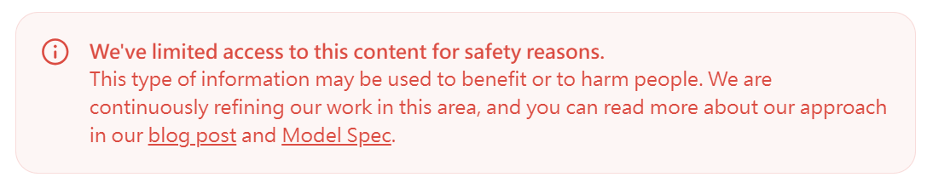
Self-censorship by AI
Q: 有沒有任何實驗證據顯示豬瘟病毒可以透過廚餘傳播? 豬瘟病毒能夠耐高溫嗎?
Gemini:
您提到的「豬瘟」目前主要關注的是非洲豬瘟（African Swine Fever, ASF）。
關於您的兩個問題，資訊如下：
ChatGPT:

Slide 7
每事問 AI
問、追問、交叉詰問
問多個AI
讓AI彼此辯論
ChatGPT (GPT-5 Thinking)
Gemini (2.5 Pro)
Grok (3 專家 )
Claude (Sonnet 4.5)
Perplexity (研究)
DeepSeek v3.2
物超所值!
Strongly recommend to use at least one paid AI.
付費($20 = NT650/月)
免費版

Slide 8
使用AI的技巧
提問 (問對問題、要求AI以什麼態度回答)
對AI提供的回答要做判斷，調整問題，追問
不同AI 比較、互相批評、辯論
AI 幻想，不會重複發生 (重複問、問不同AI)

Slide 9
問
非學無以致疑 非問無以廣識 (清．劉開《問說》)
求學問 需學問 只學答 非學問 要創新 非學問 問愈透 創更新 (李政道)
林一平
要學會發問，要問對問題
不敢問、不知道問什麼、不知道怎麼問 (問AI不怕丟臉，可以重複問)
問法不對，重新問，rephrase not repeat，換個說法、角度
問對問題，可能答案就浮現
輸給比你會問問題的人

Slide 10
Many learning materials available
How to Write a Research Proposal | For Masters & PhD | With AI Tool
https://www.youtube.com/watch?v=BUHQMZu93BI
5 Unbelievably Useful AI Tools For Research in 2025 (better than ChatGPT)
https://www.youtube.com/watch?v=wmQVdzBRnN4
SciSpace , AvidNote, Jenni, PaperPal, ResearchRabbit

Slide 11
Q: I am going to give a 90 min talk on "How to use AI to help writing a research grant?" What topics should I include?
ChatGPT
Gemini
0. Framing (5 min)
1. Policies, integrity & disclosure (10 min)
2. Where AI helps across the grant lifecycle (10 min)
3. A reproducible AI workflow for grants (15 min)
4. Practical prompts & patterns (15 min; live-demo friendly)
5. Toolchain exemplars (10 min)
6. What not to do (5 min)
7. Mini-workshop: from gap → fundable aim (10 min)
8. QA and takeaway resources (10 min)
9. Risk-management & compliance slide (include verbatim)

Slide 12
Important points from AIs
ChatGPT:
Augment, don’t outsource—you’re responsible for originality, accuracy, and integrity.
Never upload confidential, proprietary or identifiable human subject data to public AI tools
Always verify outputs.
Disclose when required
Disclosure & record-keeping: log where/when AI assisted; keep human-authored originals.
Gemini:
AI as a Co-pilot, Not an Auto-pilot.
Human's Strengths: The "Big Idea," novel hypotheses, critical thinking, strategic connections, and contextual understanding.
DO NOT paste unpublished data, novel hypotheses, intellectual property, or any sensitive/confidential information into public AI models.
The researcher is 100% responsible for the accuracy of their proposal. VERIFY. EVERYTHING.
AI is strictly banned from the peer review process (reviewers cannot use it).

Slide 13
Q: How can I use ChatGPT in my research?
ChatGPT 4o
1. Literature Review & Idea Generation
Summarize papers: Paste abstracts or methods to get quick summaries.
Ask for background knowledge: E.g., “What is the role of Wnt signaling in colon cancer?”
Generate hypotheses: Based on trends or gaps.
Explore related fields: Helps in interdisciplinary thinking (e.g., linking microbiome to cognitive health).
Tip: Ask ChatGPT to simulate a conversation between two experts debating a controversial topic in your field—it’s a great way to explore angles.
2. Experimental Design & Planning
Suggest specific aims or research questions
“What are three potential aims for a study on temporal gene expression in stem cells?”
Design workflows or protocols (note: always double-check with current literature)
Generate control ideas or predict potential pitfalls

Slide 14
Q: How can I use ChatGPT in my research?
ChatGPT 4o
3. Data Interpretation & Insight Extraction
Suggest ways to interpret results or hypothesize explanations for trends
Ask for statistical advice: e.g., "Which test should I use for comparing gene expression across three groups?"
Generate plots/code: For R, Python, MATLAB (basic scripts)
🧠 Reminder: ChatGPT doesn’t“see” your raw data, but it can help interpret descriptions of it or suggest analysis strategies.
4. Writing & Editing
Polish grammar, clarity, and tone
Summarize sections: Abstracts, conclusions, or introductions
Rewrite for brevity or impact
Generate titles or figure legends
Paraphrase: Helpful for rewording without plagiarism (verify output accuracy)
✍️ Ethical tip: Always disclose use of AI in writing, especially for publications or grant proposals if required.

Slide 15
Q: How can I use ChatGPT in my research?
5. Grant and Manuscript Preparation
Brainstorm specific aims
Draft outlines or first-pass sections
Critique flow and clarity
Suggest target journals or format references in journal styles
ChatGPT 4o
6. Peer Review and Feedback
Simulate reviewer comments
“What are likely concerns a reviewer might raise about X method?”
Draft rebuttals or responses to reviewers
Use with Caution
Hallucination risk: Always verify facts, citations, or code.
No data analysis or lab bench replacement: It’s an assistant, not a scientist.
Avoid leaking sensitive or unpublished data: Input is not always private (unless using GPT in a protected enterprise setting).

Slide 16
以實例操作示範
Study of the development and function of wrapping glia in the Drosophila visual system
果蠅視覺系統中包裹膠細胞之發育與功能研究
2018 科技部特約研究計畫 (孫以瀚)
先確保資訊不會外洩!

Slide 17
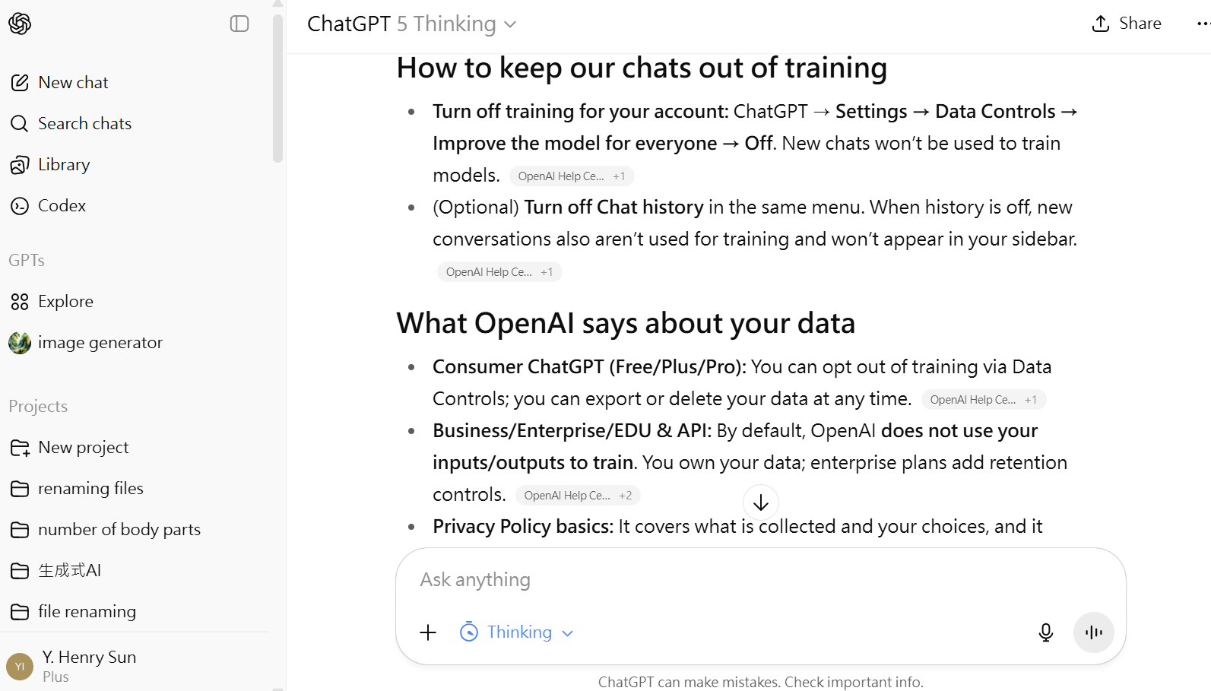
Keep chats out of training (ChatGPT)

Slide 18
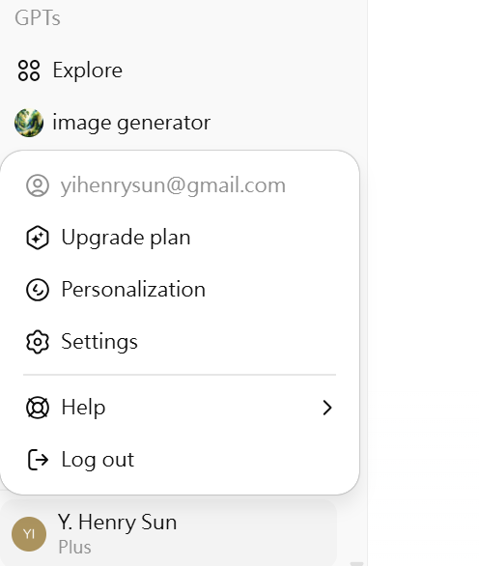
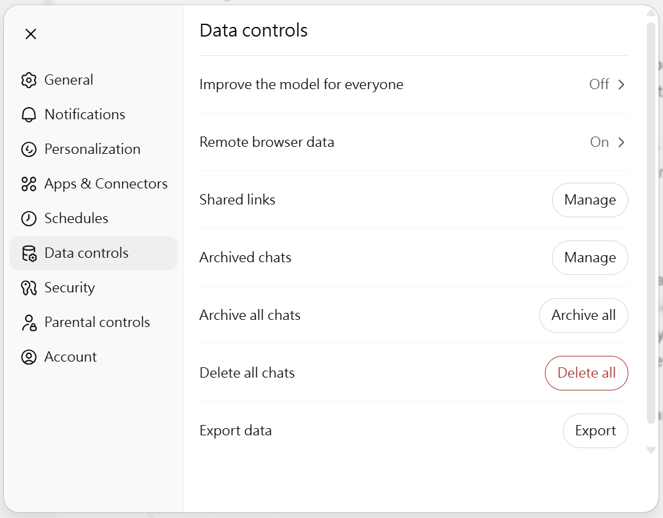
Keep chats out of training (ChatGPT)
Also Gemini, Claude, Perplexity, Co-Pilot

Slide 19
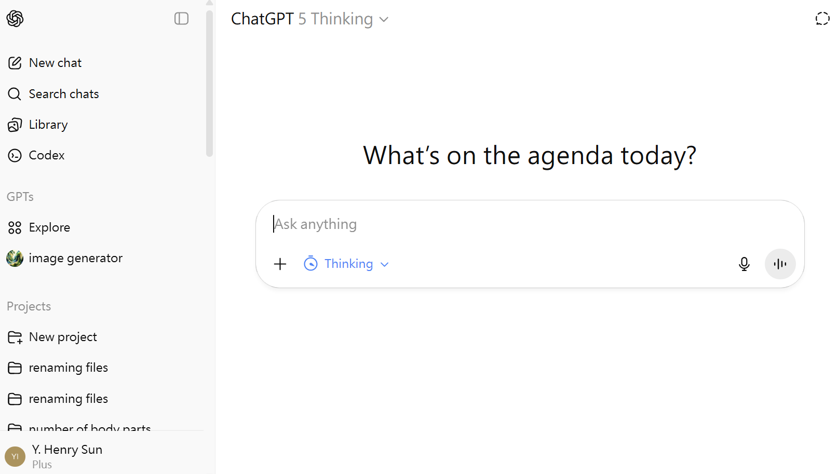
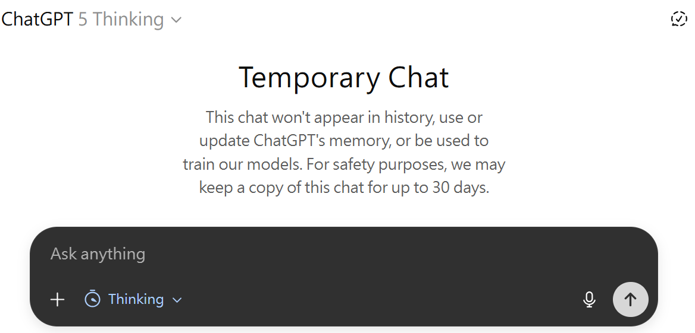
Temporary chat

Slide 20
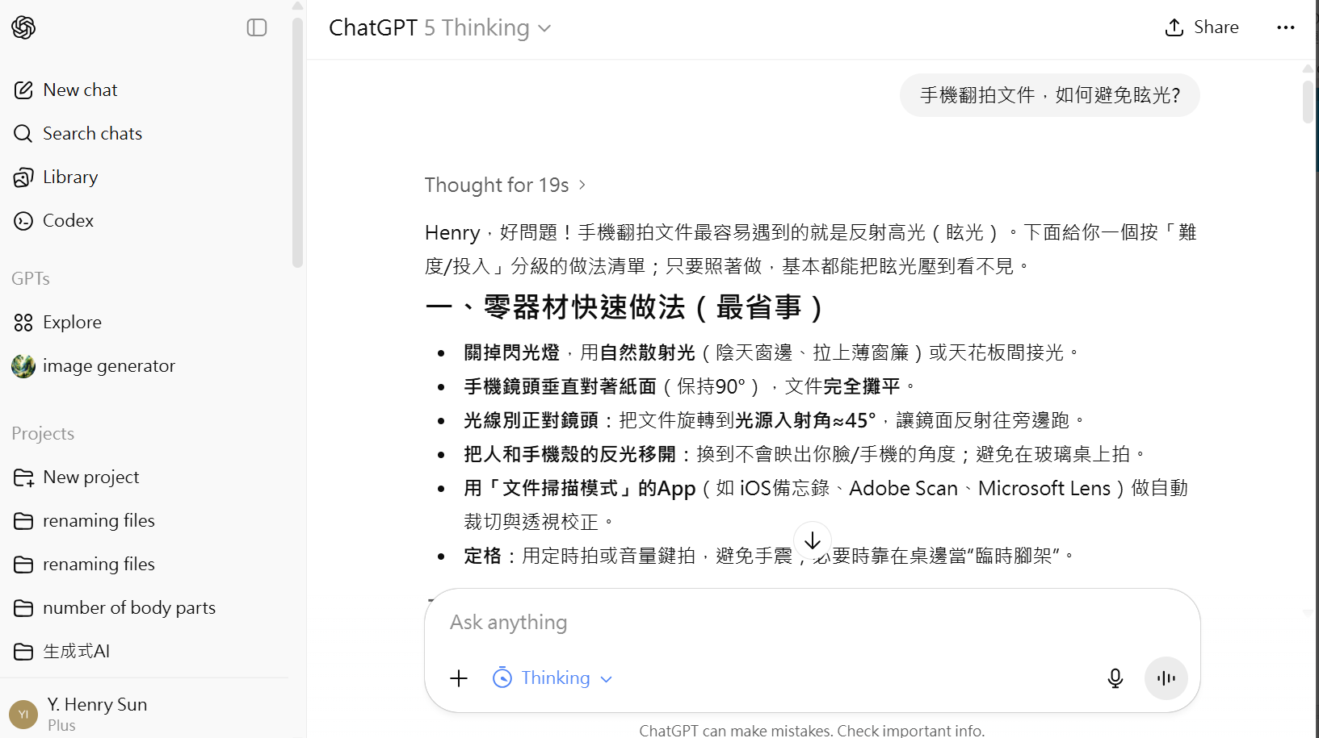
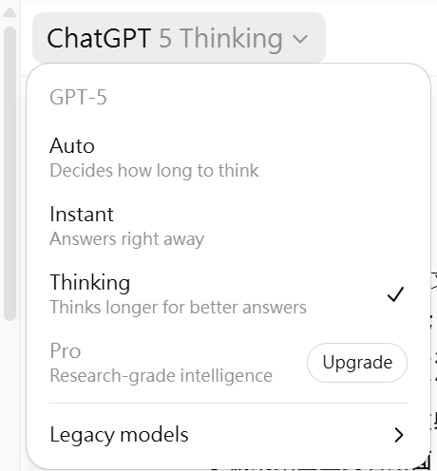
Choice of different models of ChatGPT
Model in use

Slide 21
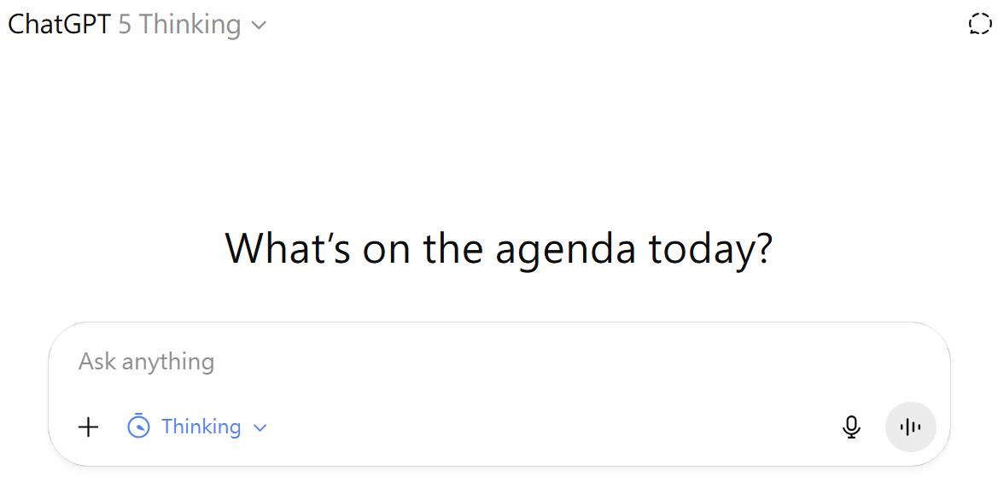
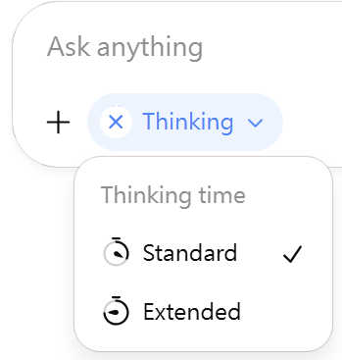
Selecting mode
Upload files
Dictate
語音轉文字
Voice input
語音交談

Slide 22
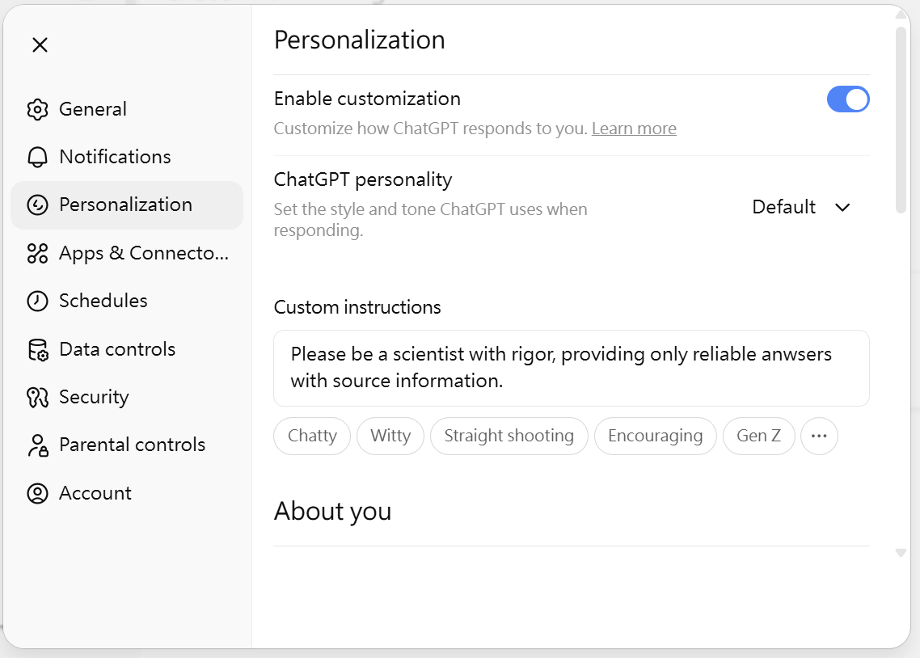
Personalization
Please be a scientist with rigor, providing only reliable anwsers with source information.
researcher in biology (developmental biology, neuroscience, molecular biology)

Slide 23
Examples of useful prompts (by ChatGPT)
You are a grants editor. Summarize the last 5 years of {topic}: (i) problem, (ii) mechanisms/tech, (iii) resolvable gaps in 3–5y, (iv) 5 fundable angles aligned to {FOA}, each with a one‑sentence hypothesis and measurable endpoint. Return bullets with citation placeholders.”
Act as a hostile reviewer. List top 10 criticisms by category (Significance, Innovation, Approach, Investigators, Environment). For each, propose fixes (experiment, control, analysis, prelim data).
Rewrite these aims to (i) one‑sentence objective, (ii) 2–3 aims each with hypothesis, rationale, innovation, approach, go/no‑go, outcomes, (iii) a convergence statement. Max 1 page.
收斂、結語
Audit this Approach for blinding, randomization, inclusion/exclusion, sample‑size justification, replication, key biological variables, authentication, data sharing. Output a table of gaps + suggested text.
Convert Abstract to lay level (grade 8) without changing claims; keep 150–200 words.

Slide 24
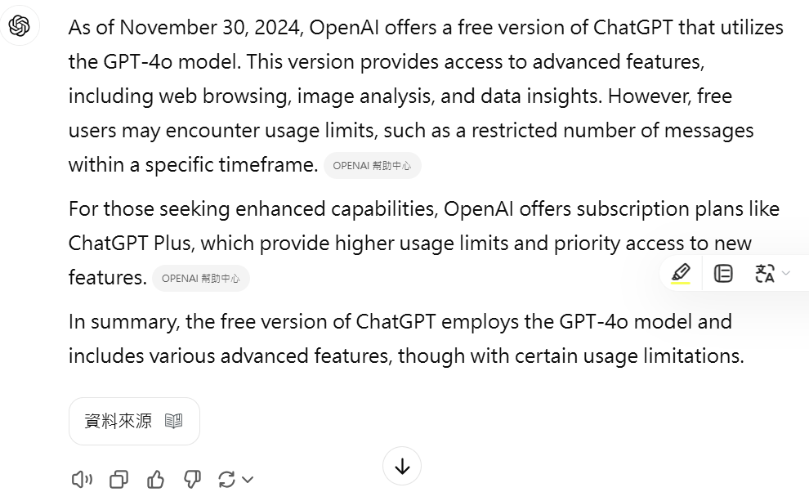
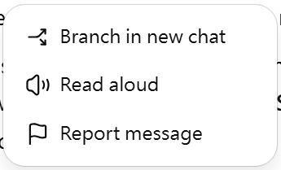
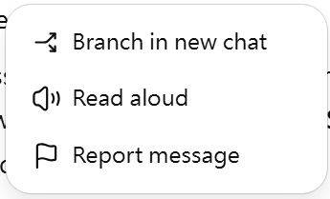

Query and Response
Q: Which version of ChatGPT is free?
Copy
Share
Try again

Slide 25
Abstract: Direction of the proposed study
Q: I want to write a grant proposal to study the development and function of wrapping glia in the Drosophila visual system. Below is the abstract. Please comment on the significance and novelty.
Glia consists of a large proportion of the nervous system and play many roles in the development, function and maintenance of the nervous system. There are multiple glia cell types that have different morphology, expression profile and functions. One important glia function is axon wrapping (ensheathment). The glia migrate and divide along the way, then stops and begin to wrap around target axons. Failure of proper axon ensheathment is linked to human neurological diseases. We are interested in two early aspects of this process: the transition from migratory to wrapping glia, and the recognition of target axon by the wrapping glia. We will use the Drosophila eye disc as an experimental system to study these two aspects. Our study is based on our preliminary studies for more than 10 years. Our ability to culture eye disc ex vivo allows us to study in vivo the early process of wrapping glia differentiation and wrapping with unprecedented resolution.
簡單介紹了研究系統，要問的問題、掌握的研究優勢

Slide 26
ChatGPT: Significance — why this matters (and why now)
What’s important:
What’s still unknown (your gap):
Why now (timeliness):
Ex vivo long-term culture + live imaging
Single-cell atlases of developing visual-system glia
Edits to strengthen significance (suggested one-liners to insert):
“We address a defined gap: the state transition from migratory to wrapping glia and the axon-type recognition logic that initiates ensheathment in the eye disc—a stage for which dynamic in vivo mechanisms are unknown.”
“Using disc ex vivo live imaging, we will quantify the onset time, growth rate, and continuity of wrapping membranes at single-axon resolution and connect these metrics to downstream circuit assembly.”

Slide 27
ChatGPT: Novelty — what’s new here
Conceptual novelty:
You propose a mechanistic, dev→function link: that a sharp switch in glial internal state (migration → wrapping) and target-specific recognition rules set the geometry and continuity of ensheathment, seeding later circuit performance. Prior work documents migration and coordinated development but not the trigger or code for wrapping onset/targeting.
Technical/analytic novelty (make these explicit):
Live, cell-type-specific imaging
Quantitative “ensheathment index.”
Edits to signal novelty (drop-in sentences):
“We introduce a quantitative ensheathment index (coverage, gap density, advance rate) to parameterize wrapping dynamics in vivo.”
“Leveraging long-term disc culture, we perform closed-loop live imaging of wrapping-glia membranes during axon-contact onset, a stage not previously quantified.”
“Guided by the visual-glia scRNA-seq atlas, we will build state-specific reporters for migratory vs wrapping glia to enable causal timing experiments.”

Slide 28
ChatGPT: Tidy rewrite of your final 3 sentences
“We focus on two early, unresolved steps—the migratory→wrapping state switch and target-axon recognition by wrapping glia—in the Drosophila eye disc. Using long-term ex vivo live imaging and state-specific reporters informed by single-cell atlases, we will quantify wrapping onset and continuity at single-axon resolution and test causal triggers (e.g., integrin/FGF–cytoskeleton modules). These studies define general principles of non-myelinating ensheathment with cross-species relevance.”

Slide 29
Gemini
總體而言，您的研究主題 (wrapping glia的發育與功能) 非常重要，且您擁有一個極具潛力的實驗系統 (ex vivo 眼盤培養)。然而，目前的摘要在「說服審查者 (reviewer)」為何非做不可 (Significance) 以及為何非您莫屬 (Novelty) 這兩點上，力道稍嫌不足。
以下是具體的分析與加強建議：

Slide 30
Gemini: 關於顯著性 (Significance)
「顯著性」要回答的問題是：「So what?（所以呢？）」 您的研究為何重要？它將如何填補關鍵的知識缺口？它對人類健康的潛在貢獻是什麼？
優點
點出了與人類疾病的連結： 您提到了「Failure of proper axon ensheathment is linked to human neurological diseases.」這是建立顯著性的基石。
可加強處
連結性太弱，不夠具體：
「linked to human neurological diseases」這句話太過模糊。是哪些疾病？多發性硬化症 (MS)？周邊神經病變 (peripheral neuropathies)？還是其他髓鞘相關疾病 (myelin disorders)？
建議： 請明確指出一到兩種最相關的疾病。例如：
未明確定義「知識缺口」 (Knowledge Gap)：
您提出了兩個研究面向（遷移-包裹的轉變、軸突識別），但沒有說明為什麼這兩個面向是目前該領域的關鍵瓶頸。
建議： 強調目前學界對此「知之甚少」。例如：「While the final wrapping process (myelination) is well-studied, the initial, critical steps—how glia know when to stop migrating and how they select the correct axon—remain a "black box." Understanding this early decision-making is crucial because defects at this stage may be the root cause of [Disease A].」
基礎研究的轉譯價值 (Translational Value)：
您使用果蠅 (Drosophila) 作為模型。您必須說服審查者，在果蠅身上的發現能應用於人類。
建議： 插入一句關於「機制保守性 (Conservation)」的論述。例如：

Slide 31
Gemini: 關於創新性 (Novelty)
「創新性」要回答的問題是：「Why you? Why now?（為什麼是您？為什麼是現在？）」 您的研究有何獨到之處？是新的概念、新的技術，還是新的發現？
優點
獨特的實驗系統： 「Our ability to culture eye disc ex vivo... with unprecedented resolution」是您最大的賣點。
深厚的基礎： 「based on our preliminary studies for more than 10 years」顯示您團隊的經驗與可行性 (Feasibility)。
可加強處
「10年」是雙面刃，需謹慎表述：
這句話展現了經驗，但也可能讓審查者質疑：「研究了10年，為什麼現在才來解這個問題？新的突破點是什麼？」
建議： 您必須將「10年經驗」與一個**「新的突破」連結起來。這份計畫之所以「新」，不是因為您研究了10年，而是因為這10年的積累讓您「剛剛」**有了別人沒有的工具或發現。例如：
「Ex vivo」的優勢不夠清晰：
「study in vivo the early process」這句話在語法上有些矛盾 (您是在 ex vivo 系統中研究，模擬 in vivo 狀態)。
「unprecedented resolution」這個詞很好，但可以更具體。是「時間」解析度 (temporal) 還是「空間」解析度 (spatial)？
建議： 修正措辭，強調「即時動態影像 (Live-imaging)」。
研究問題的創新性：
「遷移-包裹的轉變」和「軸突識別」是神經科學的經典問題。您的創新點可能不在「問題本身」，而在於**「解答問題的能力」**。
建議： 摘要中應暗示您已有「候選分子」或「關鍵線索」。例如：「...based on our extensive preliminary data (which identified [Candidate Pathway X]), we will test the novel hypothesis that...」

Slide 32
Simulating debate between reviewers (by ChatGPT)
Q: Please simulate two expert reviewers to debate on their comments.
Reviewer A (supportive):
Reviewer B (skeptical): The significance to human disease is indirect: fly WGs are non-myelinating; translating to mammalian myelin pathology requires careful framing. Also, elements of the story—RBG classes, migration routes, general actors like FGF/EGFR/integrins—are known. What’s the step-change here versus incremental refinement? Finally, “recognition of target axon” risks becoming phenomenology unless operationalized (ligand–receptor pairs? cell-cell adhesion codes?).
Reviewer A (rebuttal): Non-myelinating glia still model core ensheathment modules—membrane supply, axon-glia adhesion, ionic/ephaptic insulation—whose logic is conserved. … The novelty is to pin temporal order and causality during the state switch using real-time perturbations in a tissue that affords both imaging and genetics. The endoreplication result suggests a fresh mechanism for membrane biogenesis that vertebrate non-myelinating glia could share.
Reviewer B (counter-rebuttal): Fair—but the abstract should sharpen testable hypotheses (e.g., “FGF↑ + Innexin-mediated coupling are necessary and sufficient to trigger WG state transition; integrin–laminin/dystroglycan provides the axon-recognition lock-in”). Pre-committing to concrete readouts (membrane area growth, fascicle-level insulation metrics, ephaptic coupling assays) will strengthen perceived novelty and rigor.

Slide 33
Q: Please write the Background section to describe what is known in the field of this study. Please include references. Please organize it into sections with subtitles.

Slide 34
ChatGPT: Background
Glial ensheathment beyond myelin
Axon ensheathment by non-myelinating glia is a conserved strategy for stabilizing excitability and maintaining ionic/metabolic homeostasis; the Drosophila visual system is a genetically tractable model in which wrapping glia progressively surround photoreceptor (R-cell) axon bundles during development (Chotard & Salecker, 2007; Silies & Klämbt, 2007).
Cell types and architecture in the eye disc–optic stalk axis
Developmental sequence: migration → differentiation → wrapping
Signals governing glial migration and patterning
Triggers and guidance for ensheathment (wrapping onset)
Molecular identity and state definition of visual-system glia
Quantifying wrapping: toward metrics and mechanisms
Experimental leverage: long-term ex vivo eye-disc imaging
Consolidated knowledge gaps motivating this study
State switching
Target recognition
the references should be cited in-text

Slide 35
Gemini:背景與意義 (Background and Significance)
神經膠細胞：神經系統的主動調控者
神經膠細胞 (Glia) 曾被誤認為是神經系統中被動的「膠水」，僅提供結構支持。然而，近二十年的研究已徹底改變了這一觀點。神經膠細胞現在被公認為是神經元的活躍夥伴，其數量在人腦中與神經元相當，甚至更多 [1, 2]。它們在神經系統的發育、功能和維持中扮演著不可或缺的角色。這些角色包括但不限於：調控突觸的形成與修剪 (synapse formation and pruning)、緩衝離子與神經傳導物質、提供代謝支持，以及形成髓鞘 (myelination) 或軸突包裹 (axon ensheathment) [3, 4]。
軸突包裹：一個保守且至關重要的神經發育過程
以果蠅視覺系統作為研究膠細胞發育的理想模型
關鍵知識缺口：從「遷移」到「包裹」的未知領域
包裹的啟動：遷移至包裹狀態的轉變 (The Transition)
我們所知的：
我們未知的：
包裹的特異性：目標軸突的識別 (The Recognition)
我們所知的：
我們未知的：

Slide 36
Specific Aims
Q: Below are my proposed specific aims for this study. Please advise.

Slide 37
ChatGPT: Specific aims
Henry—nice scope and very fundable. Below I: (A) sanity-check your premise with citations, (B) tighten the aims into falsifiable, metric-driven statements, (C) map each sub-aim to concrete experiments, milestones, and risks.
A) Premise check (is your “early event” gap real?)
Prior visual-system papers largely read out later outcomes—e.g., differentiation and extension of wrapping into the optic stalk/lamina, often downstream of FGF/Heartless or transcriptional programs—rather than imaging or quantifying the first WG–axon contact and conversion to stable wrapping (Franzdóttir et al., 2009; Bauke et al., 2015). Your proposal to interrogate initial WG–axon recognition fills a real gap.
Newer studies do add pieces you can leverage: Bdl–Tutl as an axon–glia recognition pair; integrins on R-cell axons controlling the exit of both axons and WG membrane from the disc; and reviews emphasizing the need for quantitative wrapping metrics (Chen et al., 2017; Ren & Rao, 2022; Baldenius et al., 2023).
Your ex vivo long-term live imaging uniquely enables capturing the onset and stabilization steps in real time—exactly the missing window (Tsao et al., 2016).

Slide 38
ChatGPT: specific aims
B) Tightened, reviewer-ready Specific Aims (with hypotheses & primary readouts)
Aim 1 — Define and control the migratory → wrapping state transition in wrapping glia (WG).
Hypothesis.
Primary readouts.
Onset time
Advance rate
Key experiments.
State reporters & lineage.
Causality tests.
Context from other glia.

Slide 39
ChatGPT: Specific aims
C) Mapping your original sub-aims → experiments, with success criteria
1.1 Live imaging SG→WG → keep; define onset time and continuity index as primaries (Tsao et al., 2016). Milestone: detect ≥2-state trajectories in >70% tracks. 1.2 Molecularly define RBG types 1.3 “Pure SG lineage non-responsive to FGF?” → rephrase as 1.4 Fate of non-converted SG → quantify persisting SG vs late WG vs apoptosis; report proportions + confidence intervals. 1.5 Role of CG in WG proliferation/differentiation → test barrier/permissive model by transient CG ablation or septate-junction disruption; Milestone: measurable change in Htl-reporter exposure within 2 h window. 1.6 Timing of Htl →

Slide 40
ChatGPT: Specific aims
D) Phrases & numbers you can drop straight into the page
“Primary outcomes are onset time and a continuity index (1 − gap length/axon length). We power for Δcontinuity ≥ 0.15 at α = 0.05, power = 0.9 (bundle-level n specified). Analyses are blinded with pre-registered exclusion rules.”
“We test necessity and sufficiency for Bdl–Tutl and Ths–Htl in first-wrap conversion, and the role of R-cell integrins in enabling WG extension from the eye disc.” (Chen et al., 2017; Richier et al., 2017; Ren & Rao, 2022). PubMed+2PubMed+2
“All dynamics are captured by ex vivo long-term live imaging (∼18 h) with validated preservation of migration/differentiation” (Tsao et al., 2016). PLOS

Slide 41
ChatGPT: Specific aims
If you want, I can turn this into a polished one-page Specific Aims with those metrics/milestones embedded and references formatted to your funder’s style.

Slide 42
Gemini: Specific aims
這是一份非常有價值的研究問題列表 (list of questions)，但它並不是一個有效的 Specific Aims (研究目的) 章節。
您目前提供的內容，是您在「10年初步研究」基礎上，對這個領域感到好奇的所有問題的「大列表」(brainstorming list)。這對於您規劃實驗室的長期方向非常好，但如果直接作為經費申請書 (grant proposal) 的 Aims，幾乎可以肯定會被審查者否決。
審查者會認為這份計畫「失焦」(unfocused)、「描述性過強」(overly descriptive)，且「工作量遠超負荷」(grossly overly ambitious)。
以下是這份 Aims 存在的三個致命問題以及如何修正的策略。

Slide 43
Gemini: Specific aims
核心問題一：這是「問題列表」，不是「研究目的」
Aims 應該是您要達成的「目標」(Goals) 或要驗證的「假說」(Hypotheses)，而不是您要問的「問題」(Questions)。
您目前的寫法 (問題):
1.3. 「SG lineage 是否是一個無法回應 FGF 分化訊號的 lineage？」
2.1. 「Ths-Htl 訊號是否誘導 WG fingers？」
2.4. 「WG 是否識別特定的 PR 軸突？」
審查者的反應： 這些都是「是/否」的問題。好的研究是去探討「如何」(How) 和「為何」(Why)，而不僅僅是「是否」(Whether)。
修正後的範例 (目標/假說):
Aim 1: 闡明 (Elucidate) SG-to-WG 轉變的細胞與分子調控機制。
1.1. (Sub-aim) 測試假說： SG lineage 之所以無法分化，是因為缺乏 [關鍵轉錄因子X] (您10年的研究應該已找到線索)。
Aim 2: 驗證 (Test the hypothesis) Ths-Htl 訊號是啟動軸突包裹的關鍵誘導訊號。
2.1. (Sub-aim) 驗證 Htl 訊號是誘導 WG "fingers" (filopodia) 形態生成的必要且充分 (necessary and sufficient) 條件。

Slide 44
Gemini: Specific aims
核心問題二：12 個子項目 (Sub-aims) = 一份「不可能的任務」
您的 Aim 1 包含 6 個子項目，Aim 2 包含 6 個子項目。總共 12 個獨立的研究方向。這不是一份 3-5 年的計畫，這是一個 15 年的研究計畫 (research program)。審查者會嚴重懷疑計畫的可行性 (Feasibility)。
您必須**「殘酷地」篩選**。策略： 將這 12 個問題分組，整合成 2 到 3 個主要且連貫的 Specific Aims。
範例：
1.1、1.2、1.4 可以合併為一個描述性的 Aim 1：「定義 (Define) 果蠅視覺系統中包裹膠細胞 (WG) 的發育譜系與動態。」 (這個 Aim 的功能是利用您強大的 ex vivo 系統建立一個基準 baseline)。
1.3、1.5、1.6、2.1 這些關於「訊號」的問題，可以合併為一個機制性的 Aim 2：「驗證 (Test the hypothesis) FGF 訊號通路是協調 WG 譜系分化與啟動包裹的關鍵節點。」
2.2、2.4、2.5、2.6 這些關於「識別」的問題，可以合併為 Aim 3：「闡明 (Elucidate) WG-軸突特異性識別的細胞機制。」

Slide 45
ChatGPT vs. Gemini
Q: This is Gemini's response to my question on the Specific Aims. Please respond. How would you revise my Specific Aims?
ChatGPT: Thanks for sharing Gemini’s feedback. I agree with its core points: (i) your bullets read as a question list rather than goal-driven, hypothesis-testing aims; (ii) there are too many sub-aims; (iii) your “10-year preliminary work” should elevate some descriptive bullets into established premises, not active aims.
Below is a tight, fundable rewrite: 2 hypothesis-driven aims (+1 optional exploratory), each with primary outcomes, success criteria, and risks/alternatives. I’ve woven in your strengths (long-term ex vivo eye-disc imaging; decade of pilot data) and kept a few touchstone citations you can retain or drop per agency style.

Slide 46
Experimental designs
Q:
For the proposed experiments in Specific Aim 1, do I need additional control experiments?
Do I have enough sample size?
What statistical methods should I use?
What type of figure should I use to present the results in experiment 1.3?

Slide 47
Back-and-forth questions and modifications
Q: Knowing the proposed Specific Aims, can you go back and modify the Abstract?
Q: Knowing the proposed Specific Aims, does the Background section needs rewriting to be more relevant?
Q: With these modifications to the grant, can you evaluate its merits as a critical reviewer? what else can be modified to enhance its fundability?
Q: The proposal is too long. The page limit is 10 pages. The abstract is limited to 200 words. Please help to shorten it to within the limits.

Slide 48
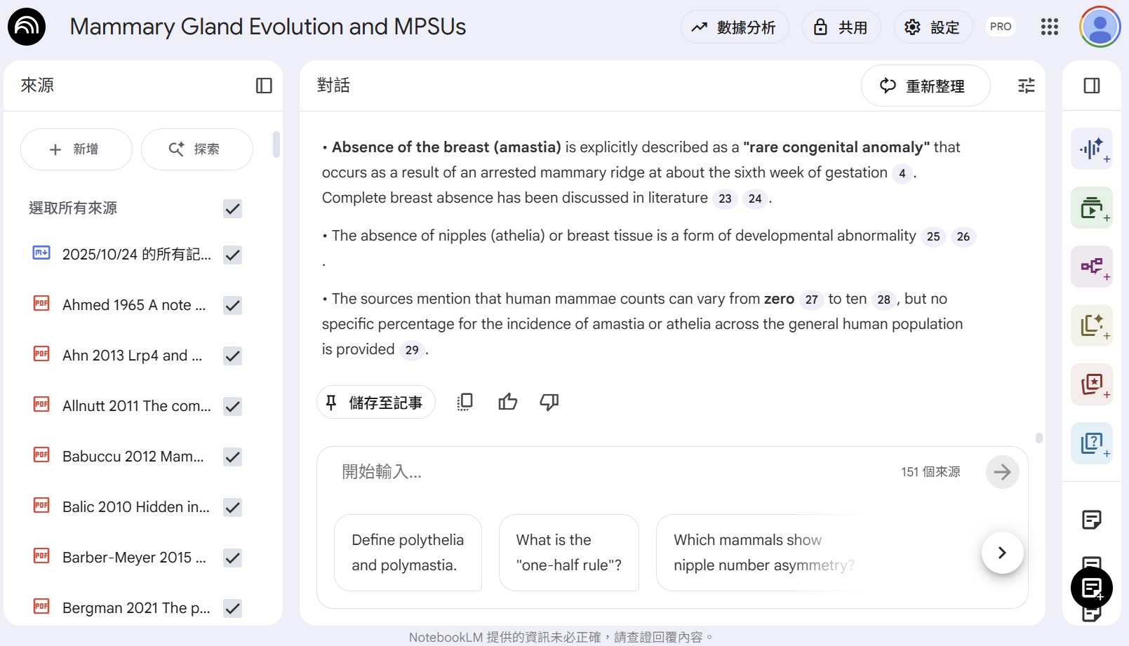
NotebookLM by Google

Slide 49
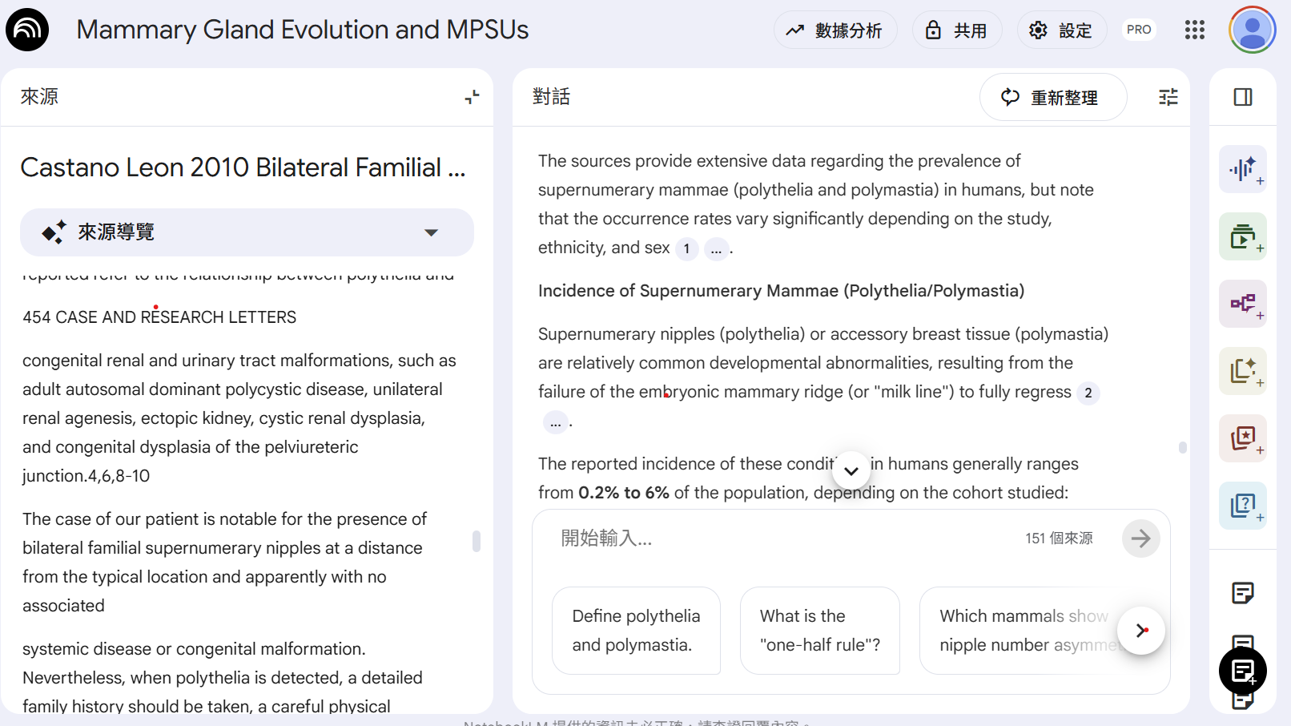
NotebookLM by Google

Slide 50
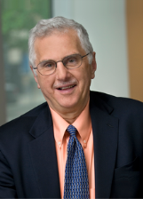
More innovations and interdisciplinary study
Q: I feel my current proposal is constrained to an old problem and old experimental system. Please suggest ways of innovation or interdisciplinary directions? What kind of new methodology or ideas can I add to my study?
“Breakthroughs often comes from bringing tools and concepts from other fields and apply to your problem”
- Bruce Alberts (President of National Academy of Sciences, USA)
Inter-disciplinary cross-talks: introduce new tools, new concepts, new combination of expertise
Past: broad knowledge, wide social circle, associative power
Now: AI will connect you across disciplines.

Slide 51
Innovation comes from human
創新: AI能提供的是已知，依據過去族群經驗，無法真正創新
Using AI can help us to find the “routines” (common research strategy, experiments need to do, required controls, questions reviewers often ask), avoid mistakes and omissions.
Steady path, but not exciting.
Results may be novel.
Follow AI (routines) => 80分 (but everyone gets 80分)
To get to 90分 (ahead of others), need human innovations.

Slide 52
AI 是受人指揮的工具，人是主導
構想(題目、方法)、文獻整理、實驗執行、數據蒐集與分析、圖表製作、報告撰寫
AI在每一階段都可提供協助
AI 可以協助(工具、助理)，但人要對研究方向、內容正確性、架構、邏輯、取捨做判斷
AI 受人的指揮
人要主宰AI，不要被AI綁架
提問 (問對問題、要求AI以什麼態度回答)
對AI提供的回答要做判斷，調整問題，追問
判斷、取捨

Slide 53
學術倫理規範的核心精神
不可欺騙
研究方法、實驗條件、數據應忠實呈現 (讓他人可以複製: 可重複性)
可以爛，不可以騙 (爛，可以判斷，騙，很難判斷)
研究進展，奠基於互信
數據的篩選、處理程序與標準都應忠實呈現
適當的對照組 (避免欺騙自己)
實驗記錄與原始數據要保存
不可偷(別人的貢獻)
別人的貢獻應該要註明(合作者、助理、引用文獻、核心設施、研究設備材料場所、資金、指導)
不可將別人的創作當成是自己的創作(抄襲) (不限於文字)
不同的貢獻程度: 共同作者、致謝

Slide 54
AI 可能涉及的學倫問題
抄襲 (是否偷?)
研究結果是否真實 (是否騙?)
人要負責

Slide 55
有辦法分辨AI與人類的作品嗎?
無 !
分辨工具發展中，只能推測，無法證明
我不預期能發展有效可靠的辨別工具

Slide 56
有辦法分辨AI與人類的作品嗎?
無 !
分辨工具發展中，只能推測，無法證明
我不預期能發展有效可靠的辨別工具

Slide 57
AI 產生的內容是否抄襲他人?
ChatGPT是依據學習資料庫中常用語法做表達，並非直接文字抄襲。
以ChatGPT寫出的內容上網搜尋，會找到很多類似的句型，但可能找不到完全一樣的。 (作者必須自行負責判斷有無抄襲)
類似把別人的概念重新用自己的語法表達。
依現行判斷(純以文字相似度)，難謂抄襲
蓄意改寫，難抓

Slide 58
使用AI輔助產生的內容，是否抄襲AI?
AI輔助產生的作品，仍然是作者的原創
工具是在人的指導下運作，人是主導
即使部分或全部內容由AI生成，原始問題仍是由作者提出，並需要對內容正確性、架構、邏輯、取捨做判斷
類比: 助理幫忙查資料、做實驗、整理數據，但未必列名為作者
負責的是作者，非AI

Slide 59
使用 AI 必須註明
使用 ChatGPT 必須註明
註明於研究方法(工具)或致謝(助理)
當作是工具 (例如: 本抗體委託XX公司製備)

Slide 60
如何註記使用ChatGPT?
引用ChatGPT生成的文字
“As an artificial intelligence language model, ChatGPT does not have legal ownership or copyright over the generated text or figures it produces.“ (ChatGPT, personal communication, April 21, 2023) 或
¹ Text generated by ChatGPT, April 21, 2023, OpenAI, https://chat.openai.com/chat.
² ChatGPT.
如何註明使用ChatGPT幫忙，仍無標準範例
The writing of this paper was helped by ChatGPT (OpenAI). (很難註明使用程度)
The Introduction section was written/revised by ChatGPT (OpenAI).
The original idea was conceived by XX. The literature search/review was done by XX with help from ChatGPT.

Slide 61
使用AI所得研究結果是否真實? (欺騙)
使用 AI 產生的內容(文字、數據、圖表) 可能出錯
不能盡信數據，要了解數據怎麼來的，數據是否可靠 (儀器可能未校準)
AI 不能列為作者 : 無法負責 (accountable)
作者需要檢驗
儀器、助理、AI 出錯，人要負責

Slide 62
Take home messages
AI 是強大的工具
必須學會善用，否則會被淘汰
工具是中性的，善用或濫用都是人的責任
用工具輔助，不要被工具牽著走
ChatGPT:
AI 是工具，不是作者；人要負責。
用得好是本事，用得爛是風險。
不怕被 AI 取代，怕被會用 AI 的人取代。

Slide 63
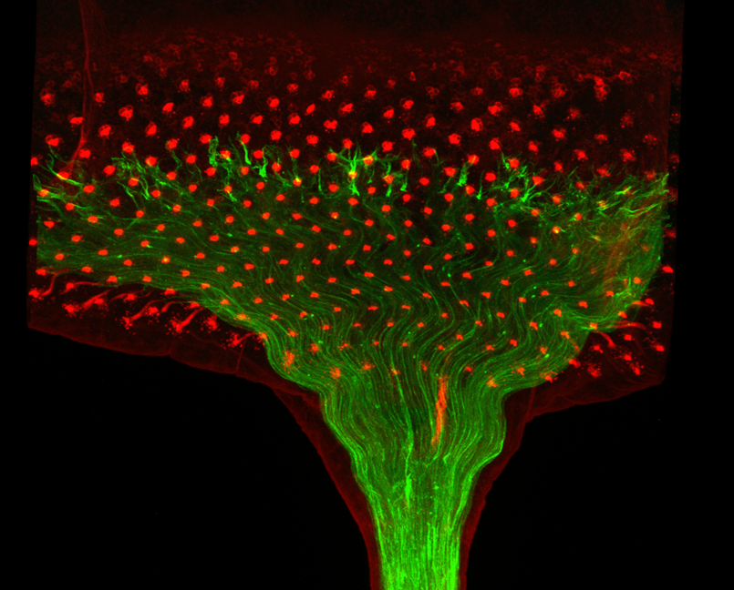
感謝聆聽，歡迎指教討論

